Slide 1
Estate planning, death & taxes
Roelof van der Merwe rvandermerwe@nexiaaustralia.com.au
Sylvia Liang sliang@nexiacourt.com.au
March 2016

Slide 2
Disclaimer
Material contained in this presentation is a summary only and is based on information believed to be reliable and received from sources within the market. It is not the intention of Nexia Court Financial Solutions Pty Ltd ABN 88 077 764 222 Australian Financial Services Licence Number 247300 that this presentation be used as the primary source of readers’ information but as an adjunct to their own resources and training. No representation is given, warranty made or responsibility taken as to the accuracy, timeliness or completeness of any information or recommendation contained in this publication and Nexia Court Financial Solutions will not be liable to the reader in contract or tort (including for negligence) or otherwise for any loss or damage arising as a result of the reader relying on any such information or recommendation (except in so far as any statutory liability cannot be excluded). This presentation has been prepared for general information and not having regard to any particular person’s investment objectives, financial situation or needs. Accordingly, no recommendations (express or implied) or other information should be acted upon without obtaining specific advice from an authorised representative. Please note past performance may not be indicative of future performance.

Slide 3
Is it a good time to talk about tax today?
Is it a good time to talk about death today?

Slide 4
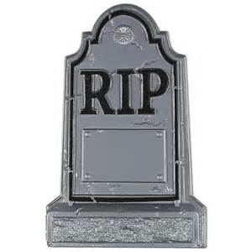
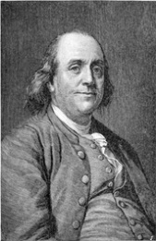
Why should we talk about death & taxes?
Everyone dies
Benjamin Franklin
1789
Planning beforehand for retirement, lifestyle choices & illness
Managing your assets to ensure:
Welfare of dependents
Security of assets
Smooth succession of the business
Charitable giving
Other jurisdictions = estate taxes (tax on all assets you have)
Goldsmith 1997

Slide 5
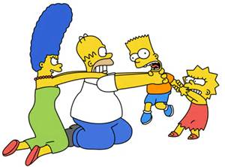
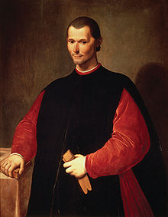
Death gives rise to myriad of tax planning opportunities.
However, this is a tightrope as there’s a high risk of family disputes
Niccolo Machiavelli

Slide 6
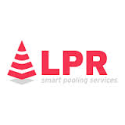
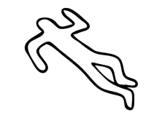
What happens when you die? (1)
Executor if = will
Administrator if ≠ will (intestate) / will revoked
= legal control of estate
Deceased Estate
Winds up deceased’s personal affairs
Obtains probate of the will
Property of deceased estate once probate
(transfer assets into name of LPR)
Deceased / Testator owns property
Dies
Unused losses of the deceased cannot be carried forward to the deceased estate
TT
Beneficiaries
Trustee of TT treated same way as LPR (PS LA 2003/12)

Slide 7
What happens when you die? (2)
May contest will
May no longer contest will
Individual dies
X
Executor appointed by will
Administrator appointed by court (if intestate)
Probate granted
Estate administered
1
2
Assets now vest in LPR who can sell assets to pay debts & testamentary expenses
3
20 September 2015
25 November 2015
15 May 2017
LPR holds property as trustee
LPR administers estate as executor / administrator
Apply net income to reduce debts
Deceased Estate
LPR can now start administering estate
Distribution to:
beneficiaries; or
testamentary trust
Probate = Supreme Court legal document that:
Officially proves that will is valid & latest version
Authorises executor to collect assets of deceased & administer estate
Automatic
Formalities
Advertise intention to apply for probate at least 14 days before file for probate
Apply with original will, death certificate, inventory of assets & liabilities

Slide 8
Why is estate planning so important?

Slide 9
Statistics…
$46m has been transferred to the NSW Treasury over the past 5 years due to unclaimed estates or individuals who died intestate.
Public Trustee, NSW

Slide 10
What is estate planning?
To ensure your wealth passes to the right beneficiary, at the right time, in a tax effective manner
Wealth is held in a variety of ownership forms and each person’s estate planning objective is different
Failure to plan well may result in…
A reduction in the wealth passed onto intended beneficiaries
Unnecessary tax liabilities
Benefits passing to the wrong beneficiaries

Slide 11
Common factors to consider
Will
Legal document that deals with estate assets
Power of attorney
Legal document which allows you to appoint a person to make financial decisions on your behalf
Enduring guardianship
Legal document which allows you to appoint a person to make personal and lifestyle decisions on your behalf should you lose mental capacity
Advance health directives
Legal document which you can express your wishes about medical treatment and how you like your body to be dealt with in the event of an accident

Slide 12
What happens if you don’t have a will?
Different intestacy rules in each state
dies leaving:
1
Only
Spouse gets everything
Spouse
Spouse gets first $350k and:
Interstate’s personal effect, and
½ of balance of estate
Children share balance between them
2
+
Spouse
Kids
3
Not the same in each state
Only
Children share estate equally
Children
4
Only
Parents share estate equally
Parents
5
Only
Siblings share estate equally
Brothers & sisters

Slide 13
Estate vs. non-estate assets
Estate assets include:
Assets owned in your own name solely
Assets owned with another as tenants in common
Super death benefit paid to your estate
Self owned life insurance policies
Non-estate assets include:
Jointly held assets (joint tenants)
Life interest in assets
Assets owned by a company
Assets owned by a trust
Super death benefit paid to a beneficiary
Life insurance policy paid direct to a nominated person

Slide 14
Estate planning is not just about what happens on death
By then it’s too late to change things
Estate planning is also about the right ownership of assets today
Review your estate plan if there is change in circumstances e.g. marriage, child birth, divorce, death of beneficiary, change in property etc.
Estate planning is the fundamental principal about financial planning
Achieving goals and objectives
Maximising wealth
Having the right level of control
Passing your wealth to the right people at the right time
Protecting your wealth

Slide 15
Estate planning process
1
Gather Information
2
Identify issues and objectives
3
Options and strategy
4
Recommendations
5
Implementation
6
Review

Slide 16
A team approach
Financial Advisors
Lawyers
Accountants
Estate Plan and Financial Plan should be a co-ordinated approach

Slide 17
Some tax consequences on death

Slide 18
CGT & death
Death itself ≠ CGT event
But things that happen because of death may be a CGT event (e.g. asset passed on to LPR/beneficiary)
But ignore capital gain / loss if assets passed on per “normal career path” and no K3 (exempt, super & foreign beneficiary)
Consequences for transferor
Div 128 rollover
Consequences for transferee
CB & acquisition date

Slide 19
Normal “career path” for CGT assets on death Situation 1, 2 or 3
Deceased
1
≠ CGT for deceased [128-15(3)]
≠ CGT for deceased ([128-10]
1
2
≠ CGT for LPR/Deceased estate
2
≠ CGT for LPR
TT
Trustee of TT treated same way as LPR (PS LA 2003/12)
3
≠ CGT for TT [128-15(3) & PS LA 2003/12]
Will be CGT if:
LPR sells assets to settle debts of estate
Beneficiary eventually sells assets
“Abnormal” beneficiaries
Tax advantaged [e.g. exempt (Div 57) or superfund (s128-25)]; or
Foreign beneficiaries (Subdiv 855-B)
“Normal” beneficiaries

Slide 20
Situations where Division 128 rollover will apply
An asset must pass pursuant to Situation 1, 2 or 3
When does an asset pass?
If done by:
Will
Intestacy rules
Satisfaction of monetary legacy
Deed of arrangement
Court order varies distribution
No tax on passing of assets under a will
Later arrangement made via agreement or court order that supersedes will (must be made before estate is completely administered)
If beneficiary buys an asset from LPR, no 128 rollover

Slide 21
No CGT if swap assets received under will (and entered deed of arrangement to allow swap)
OK for beneficiaries to swap assets if s128-20 Deed of arrangement:
Parents leave assets to beneficiaries who can’t use them
Australian house to son who lives in South Africa
South African house to daughter who lives in Australia
Swap assets after death (by deed of arrangement)
Will
House A
House B
House B
House A
No CGT even though assets did not pass under will (but was valid deed of arrangement)
Must be executed before the administration of the estate is complete

Slide 22
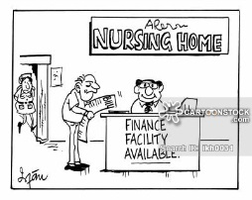
MR exemption if MR passes on/after 20 August 1996 (s118-195)
When deceased acquired it
1
Because anyway ignore pre CGTgains
No requirement for deceased to have used it as main residence (but must have been MR @ some time)
Just before death:
Used as deceased’s main residence; and
Not used to produce income (e.g. rented out)
Dwelling passed to beneficiary
20 September 1985
Beneficiary acquired it after 20 August 1996
Full exemption for beneficiary if:
2
Commissioner may extend the 2 years
1
Dispose (i.e. settlement – the mere entering into a contract of sale ≠ enough) within 2 years of DOD (But no need to use as main residence in this 2 years)
OR
2
From date of death till disposal (settlement), was not used to produce income & was main residence of
Spouse (the one just before death)
Individual with right to occupy under will; or
Beneficiary under will
Same conditions provided dwelling passed to beneficiary/trustee after 20 August 1996
Must move into main residence as soon as practicable (i.e. just after probate) (s118-135)

Slide 23
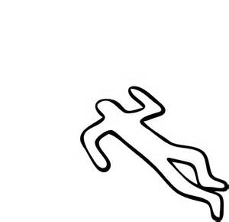
Small business CGT concessions Can get it if dispose within 2 years of death
Can get SB CGT concessions if:
Dispose of assets within 2 years of death; and
Deceased would have qualified for SB CGT concessions if had disposed of assets just before death (s152-80)
LPR, beneficiary & surviving joint tenant
Died
= automatic SB CGT concessions
No need for assets to be active
≠ automatic SB CGT concessions
Assets must be active (used in business) by LPR,beneficiary or TT
Post 20 September 1985
2 years from DOD
This means active assets (e.g. goodwill, business premises etc.) owned by deceased can remain active assets if sold within 2 years of death
So asset does not have to remain active in that 2 years
2 year freebie
But no 2 year freebie if assets used in business carried on by affiliate/connected entity

Slide 24
Death and 15 year & retirement exemption Workaround / patches
Treat as if conditions for exemption = satisfied [s152-80(2)]
Difficult to satisfy conditions as deceased already dead
15 year exemption conditions (s152-105(d)
≥ 55 & retired; or
Permanently incapacitated
Deemed to be satisfied
Retirement exemption conditions (s152-305(1)(b)
If < 55, must contribute CGT exempt amount to super
Not necessary to do this
Arguably still necessary to specify amount of capital gain disregarded (when lodge tax return to measure $500k cap

Slide 25
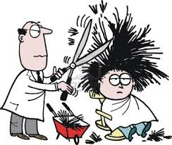
Small business rollover, J2 & death (1)
Ordinarily gain from sale will be rolled over
But J2 happens on sale of replacement asset (that was bought within 2 years of death / 1 year before death)
But no J2 if deceased dies before can sell replacement asset
Fabio
35 years
Purchases new salon for $1.5m within 2 years
3 years later Fabio sells replacement asset for $1.8M
Sells salon for $400k gain
CGT event J2
Replacement asset rollover of $100k
Applies:
CGT discount
50% reduction
2 Capital gains:
$100k (original gain that received rollover)
$300k (capital gain on replacement asset)
Replacement asset
Apply CGT discount & CGT reduction to $300k replacement asset gain = $75k
Net gain = $100k
This means $175k gain in year
Potential to apply to $175k gain:
Retirement exemption
Rollover relief
*s104-185

Slide 26
Small business rollover, J2 & death (2)
If deceased died while subject to rollover
No capital gain for LPR/beneficiary/TT
CGT event (Sells asset)
CGT event (Deceased died)
10 May 2012
10 May 2013
10 May 2014
10 May 2015
2 Years to get replacement asset
Ordinarily J2 capital gain
(but disregarded here per s128-10)
Permanent disregard of J2 gain on death
Strategy: rollover gain if expect death
No need to get on a plane like Goldsmith 1997

Slide 27
Division 7A & death of a shareholder
To avoid exposure, must do certain things by certain dates:
Put complying loan agreement in place by lodgement day
Make minimum yearly repayment by year end
Deemed dividend exposure depends on when shareholder died
If die after lodgement / end of year without doing 7A steps
If die before lodgement day / end of year without doing 7A steps
= 7A exposure
≠ 7A exposure
Make loan in 2015
Put complying loan agreement in place
2
1
1st MYR (interest & principal) repayment
Loan
30 June 2015
Company lodgement date (e.g. 31 March 2016)
30 June 2016
If fail to make compliant (1) or make MYR (2), deemed dividend will be triggered at 30 June 2015
Safe-ish period to die if have not done anything
Safe-ish period to die if have made loan compliant but have not paid MYR

Slide 28
Division 7A & Death Duties of LPR
Good news from Division 7A perspective
That LPR does not need to pay later MYRs
As no deemed dividend in DOD return or for deceased estate
However, LPR has to get rid of the loan to complete administration of estate & determine net amount to be distributed
But watch out for personal liability of LPR / TFM claims if distributed gross assets without repaying the loan
Ways for LPR to get rid of loan
Repayment (from funds of estate)
Seek forgiveness of loan from company (potential Division 7A exposure)

Slide 29
Checklist Some tax issues when drafting an estate plan
Beneficiaries
Avoid K3 by only passing on pre CGT assets to NR, tax exempt or superfund
Avoid existing losses of beneficiary to become trapped by passing on post CGT assets (which they can later sell at a capital gain) to beneficiaries
Testamentary trusts
Ensure minor = taxed @ adult rates & gets $18,200 threshold
Use this for high income beneficiaries to stream capital gains & franked dividends
Main residence
Where relevant, provide right of occupation to beneficiary to ensure qualify for MR
Superannuation
If part of estate, should go to tax dependants (e.g. superannuation proceeds trust)
Allow LPR to continue carrying on a business?

Slide 30
Example showing why you should do estate planning
Father has $9m estate and wants equal division for 3 sons(i.e. $3m each)
Because of tax attributes, net effect ≠ the same for each beneficiary
Son who get MR = best position
Watch out for K3 with transfer of non-TAP assets to NR son C
Asset | Beneficiary | Tax consequences
$2m main residence (post CGT) | Son A | CB for Son A = MV @ DOD Son A = MR exemption if sell house within 2 years of father’s death (without having to use it as MR) If sell after 2 years, have to use it as MR
$2m investment property (pre CGT) | Son B | CB for Son B = MV @ DOD Son B = subject to CGT on subsequent sale of property
$2m cash | $1m to A; $1m to B | No CGT consequences as cash ≠ CGT asset
$1m investment property (Post CGT TAP) | Son C | No K3 (since property = TAP) CB for Son C = CB @ DOD Son C = subject to CGT on subsequent sale of property
$2m shares (Post CGT Non-TAP) | Son C | K3 capital gain in DOD return since shares = non-TAP and Son C = NR Reduce amount of residuary deceased estate available for distribution since deceased estate must pay for CGT on K3

Slide 31
Take aways
A variety of issues can influence your estate plan!
These are not always straight-forward
Speak to your Nexia adviser to guide you through the process
Later seminars in 2016 on:
Superannuation & death
Testamentary trusts

